Slide 1
WHAT’S BETTER?
Rotating Fan vs. Air Purifier
By: Sylvia Miller, Ella Varner, Ava Wilcox, and Casie Stornetta
Corvallis High School, Chemistry, Mr. Hammill

Slide 2
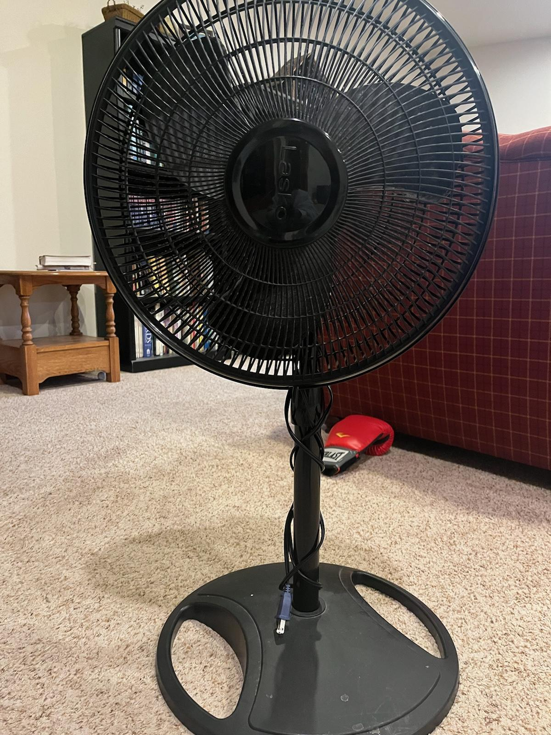
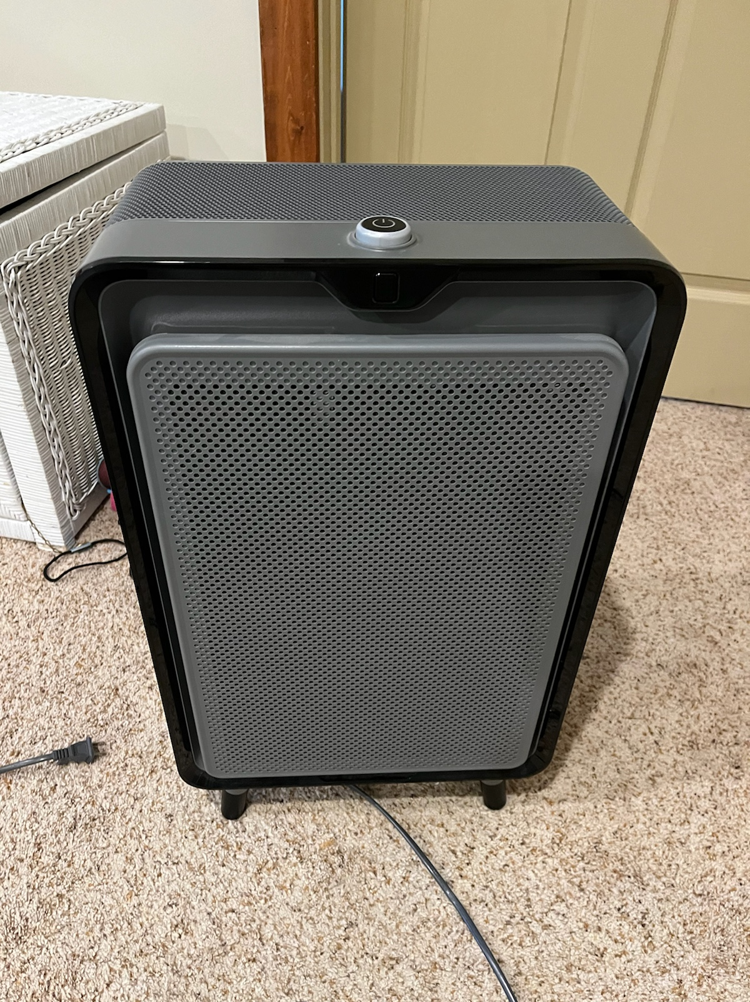
Question + Hypothesis
Is a rotating fan as effective as an air purifier for improving the PM2.5 levels in a singular room?
If we use a fan and an air purifier to manipulate the PM2.5 levels in a room, then the fan will have a lesser effect in comparison to the purifier.

Slide 3
Background
Indoor air contain pollutants due to toxins from cleaning products, building materials, cooking, etc.
Fans circulate indoor air, allowing for fresh air to be introduced into a room
Helps reduce fumes that have settled into an area
Can decrease the chances of mildew and mold growth
1 in 4 U.S households own an air purifier
Around 70% of U.S households own a rotating fan

Slide 4
PROCEDURE
Conduct 3 different control tests (30 min each) of all 3 variables: static room rotating fan on and purifier on.
For smoke control test, light 2 candles and leave for 30 min. Blow them out, remove them from the room, close door and leave testing area for another 30 min.
For the fan trials, light 2 candles and leave for 30 minutes. Once time is up, blow them out, remove them from room, turn on the fan and leave for another 30 minutes. Air out the room once test is over. Conduct this test 4 times total.
Repeat this process 4 times for the purifier trials.

Slide 5
Bedroom Layout:
Bookshelf
Candle
Bed
Desk
10.7 ft
Candle
Sensor
Door
Where we placed fan/purifier
13.7 ft

Slide 6
Independent Variables:
Air purifier and rotating fan
Dependent Variables:
PM2.5 Levels
Controls:
The room we used for testing
The candles we used and where we placed them
How long we ran the trials for
The type of fan and purifier that we used
Materials:
Fan - Wynd Tracker
Purifier - Iphone (Wynd app)
2 candles + lighter

Slide 7
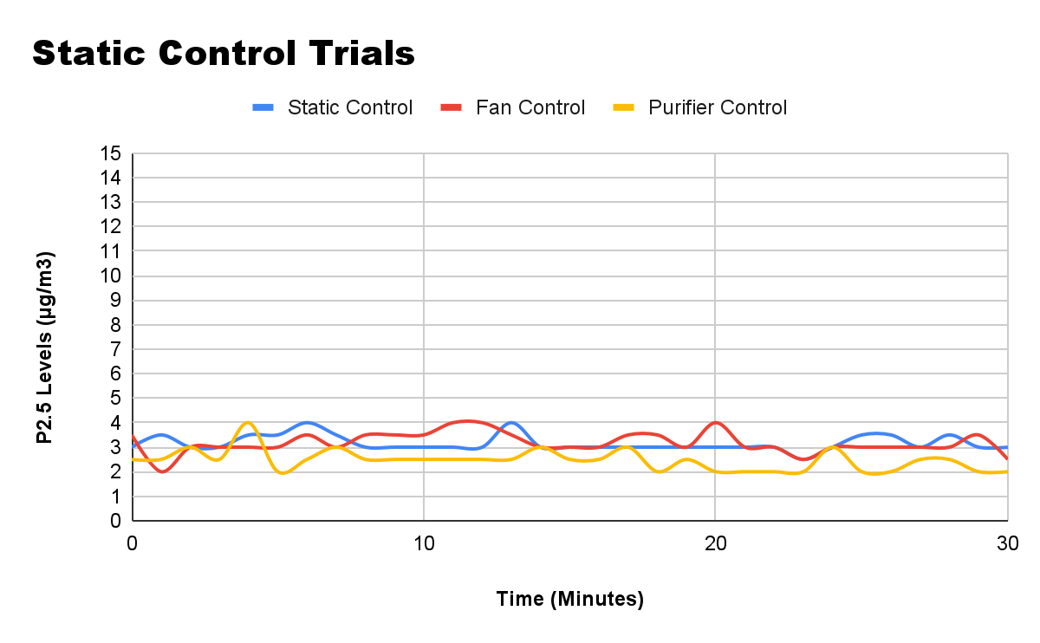
Turned on fan and tested for 30 min
Started testing with no fan or purifier
Turned on purifier and tested for 30 min

Slide 8
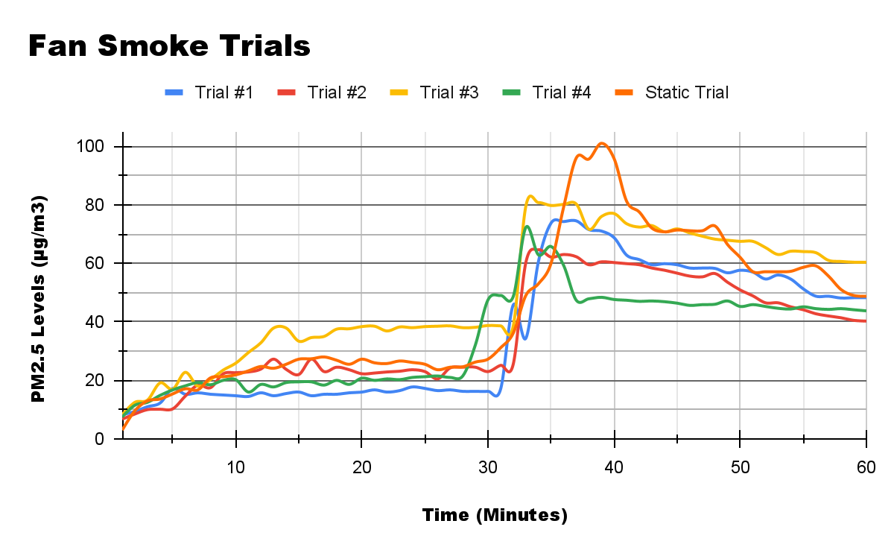
Did not turn on fan for this trial; we used it as a control
Blew out candle at 30 min mark and also turned on fan
Starting Candle

Slide 9
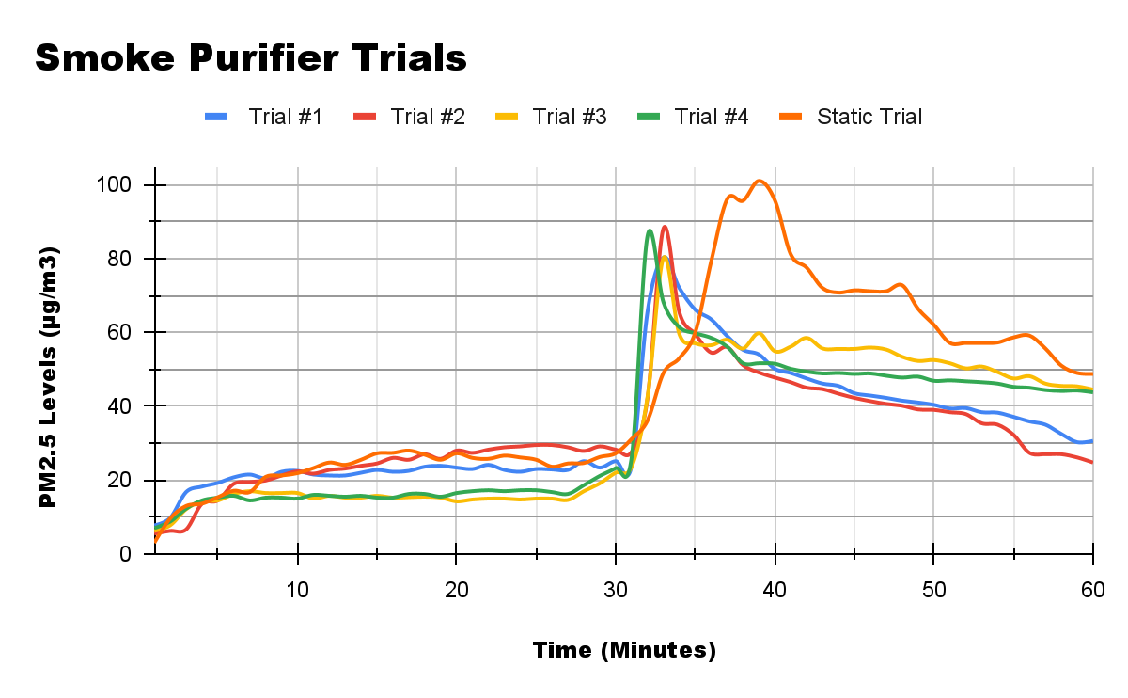
Did not turn on fan for this trial; we used it as a control
Blew out candle at 30 min mark and also turned on purifier
Starting
Candle

Slide 10
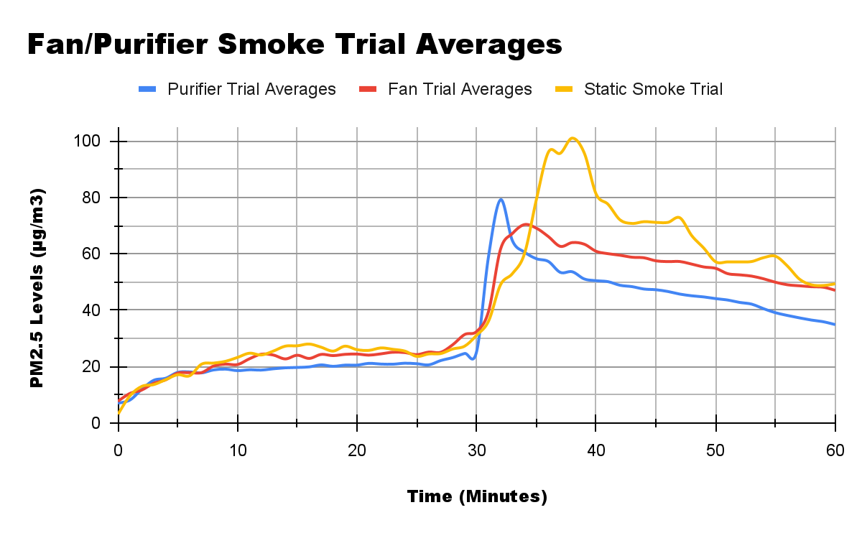
Blew out candle at 30 min mark and also turned on fan or purifier
Average PM2.5 level after exposed to smoke: 65.5 µg/m3
Starting the candle
Average PM2.5 level after exposed to smoke: 47.8 µg/m3
Average PM2.5 level after exposed to smoke: 56.3 µg/m3

Slide 11
CONCLUSION:
In conclusion, our hypothesis is correct; The fan wasn’t as effective as the purifier in bringing the PM2.5 levels down.
What we could’ve done better:
Tested a variety of fan and purifier brands
Tested for longer
Done tests in a variety of rooms w/ different sizes, floors types, etc
Solutions:
If you have the option, use an air purifier to help maintain good PM2.5 levels but a fan is a good second option

Slide 12
REFERENCES:
https://www.onehourheatandair.com/
https://childersheatingandairconditioning.com/
https://ehs.umass.edu/
https://ehs.umass.edu/
https://www.epa.vic.gov.au
Question
Is a rotating fan as effective as an air purifier for improving the PM2.5 levels in a singular room?

Slide 13
QUESTIONS?

