Slide 1
Natural Pine Logs vs. Compressed Logs on PM 2.5 Concentrations
By: Liam Harvey, Owen Savage, and Benton Loraas Corvallis High School, Chemistry, Mr. Hammill

Slide 2
Will burning firewood or compressed logs increase PM 2.5 concentration more?

Slide 3
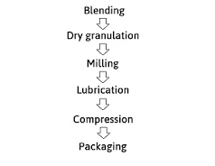
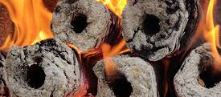
Background Info
Compressed Wood
Invented in 1930
Made out of clean dry sawdust, wood shavings and leftover greens under intense pressure without glue
Used in military field kitchens and anywhere weight was an issue

Slide 4
Hypothesis
If we burn compressed logs instead of real firewood, there should be a decrease in particulate matter concentrations.

Slide 5
Methods
1
2
3
4
5
Measure Baseline
Start the Fire
Let it Burn
Put out the Fire
Repeat the process

Slide 6
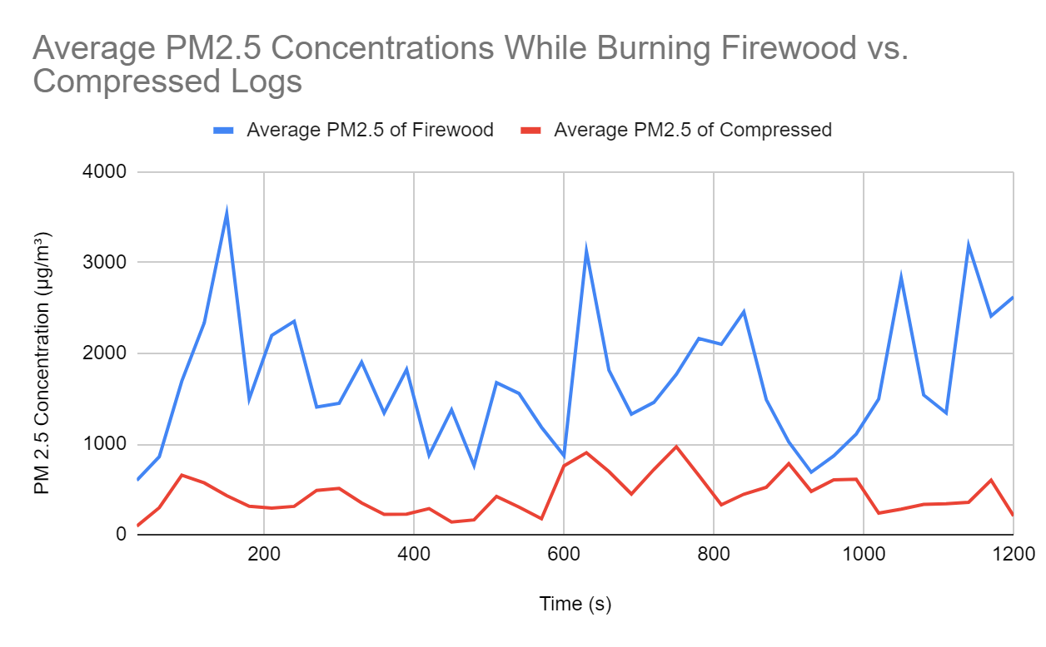
Results
The Logs Start to Burn
Overall Average Concentration:
Firewood: 1704.09
Compressed Logs:
439.83

Slide 7
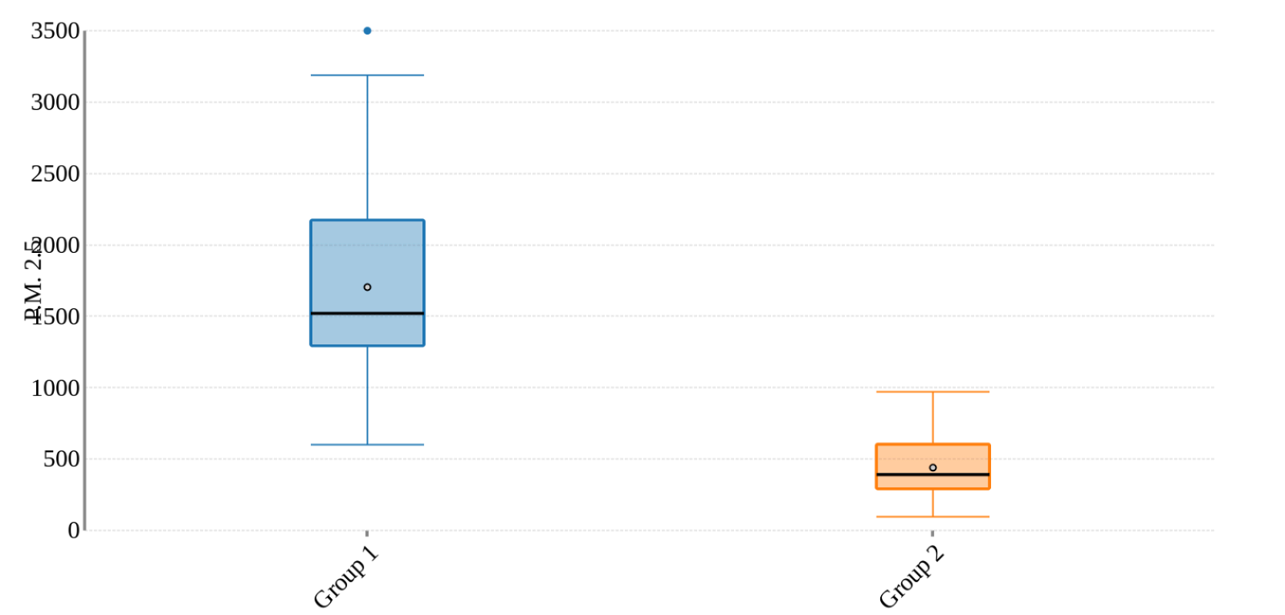
(Real Firewood)
(Compressed Logs)

Slide 8
Conclusion
Errors and Next Steps
Firewood creates substantially more PM2.5 Concentration
Choose compressed wood
You can burn compressed wood for less smoke at a campfire
Our hypothesis was correct
Errors:
Wind Control
Brands of Wood
Next Steps:
Other types of compressed logs
Trying different locations

Slide 9
Citations
E.J.S. Mitchell, B. Gudka, C. Whittaker, I. Shield, A. Price-Allison, D. Maxwell, J.M. Jones, A. Williams, The use of agricultural residues, wood briquettes and logs for small-scale domestic heating, Fuel Processing Technology, Volume 210, 2020, Retrieved May 10, 2024, from https://www.sciencedirect.com/science/article/pii/S0378382020308432
Donnell, R. (2022). Pres-To-Logs Has History Of Its Own. Timber Processing. Retrieved May 10, 2024, from https://www.timberprocessing.com/pres-to-logs-has-history-of-its-own/
Julie Schobing, Axel Meyer, Gontrand Leyssens, Nabila Zouaoui, Olivier Allgaier, Fabrice Cazier, Dorothée Dewaele, Paul Genevray, Coralie Pusca, Fabrice Goutier,
Inventory of the French densified log market: Characterization and emission factors measurement of twenty commercial briquettes, Fuel, Volume 335, 2023,.
(https://www.sciencedirect.com/science/article/pii/S0016236122038844)

Slide 10
Questions?

